Slide 1
Pytest Django

Slide 2

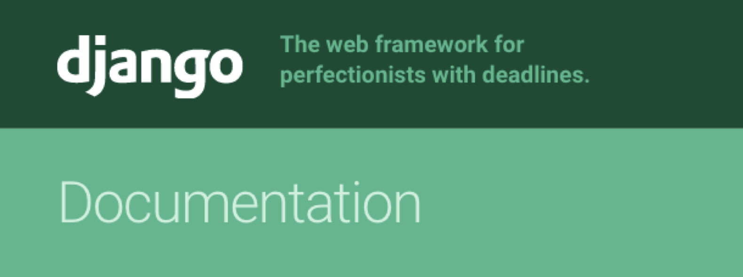
Django testing framework
“Inherits” from unittest
Tests are organized in django.test.TestCase classes
Each method uses various assert* methods to verify expected outputs

Slide 3
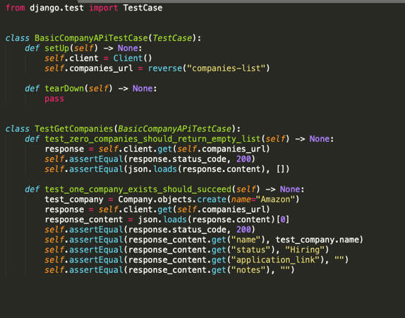

Slide 4


Under the hood: django does some crazy stuff on top of the unittest. so when we use TestCase class…
Create test databases for our test run
For each test creates a transaction so that each test can be rolled back after the test case.
Set up utilities such as testing client

Slide 5

What’s wrong with django
testing framework?
Nothing really, it gets the job done
A lot of boilerplate code (test classes, weird assert methods)
If you are running tests which don’t use DB you are wasting resources.
Composition over inheritance

Slide 6
Why use pytest-django instead of Django's testing framework?
Nothing really, it gets the job done
A lot of boilerplate code (test classes, weird assert methods)
If you are running tests which don’t use DB you are wasting resources.
Composition over inheritance

Slide 7
@pytest.mark.django_db
Just like in django.test.TestCase To get access to the Django test database
Each test will run in its own transaction that will be rolled back at the end of the test.
Client
We use it for each request to our app Just like in in django.test.client pytest-django has a build-in fixture client

Slide 8
